Slide 1

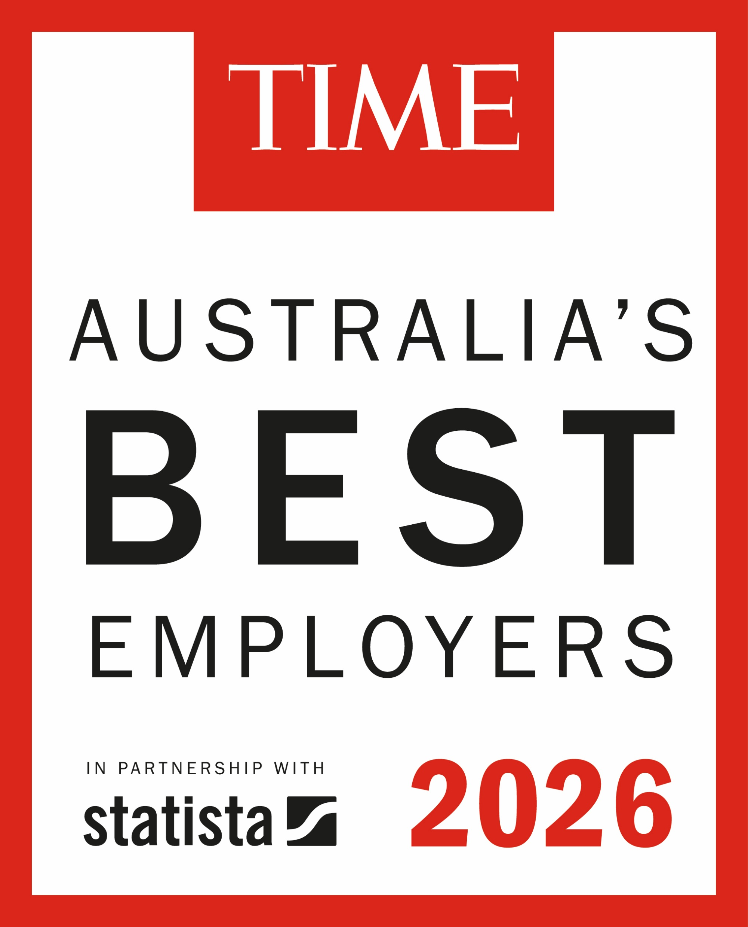
Australia’s Best Employers 2026
methodology
Scope, Data Collection, Evaluation and Results

Slide 2
Australia’s Best Employers recognizes organizations that create an attractive work environment for their employees
1
Methodology + Summary
Methodology
  Australia's Best Employers were selected through an independent study conducted on a broad sample of employees working in companies with at least 200 employees in Australia.
  The survey was conducted using several online access panels, ensuring a representative sample of employees in Australia. Each respondent was asked, in an open-ended question with an auto-complete option, to indicate the company or institution they work for. The study included companies from all sectors employing at least 200 people in Australia. To build the evaluated sample, the study included more than 200,000 employer evaluations.
  The final score is based on two types of evaluations: employees’ willingness to recommend their own employer and their willingness to recommend other employers within the same industry in which they are currently employed. Greater weight is given to the willingness to recommend one’s own employer.
  Completing the questionnaire took an average of 8-10 minutes.
  The 300 companies that achieve the highest total scores will be awarded the title of “Australia's Best Employers 2026."
Executive Summary
Title of ranking: Australia's Best Employers 2026
Media partner: TIME
Edition: 2nd
Number of awardees: 300
Methodology: Survey
Criteria used for determining rank: Willingness to recommend one's own employer and willingness to recommend employers from other companies within the same sector.

Slide 3
Australia’s Best Employers follows a proven approach to determine the ranking
2
Process
Data-based results
Organizations are researched to verify that they fit the project‘s scope. Data is gathered via publicly available company information
The final ranking is published by TIME with the top organizations deemed Australia's Best Employers 2026, offering visibility and recognition to the leading companies in the country.
Data Gathering
Additional Research
Analysis
Publication
  The Survey is programmed and responses are gathered. Incoming data is cleaned and prepared for analysis
The prepared data is analyzed with a proven scoring model to create a ranking of the highest rated employer brands. Further evaluation is made on demographic and industry levels to gather insights into the Australian labor market.

Slide 4


The evaluation is based on data collected through online panels, with over 200,000 employer evaluations
3
Data Collection
Data collection through online access panels
Online Access Panel
An online access panel is a sample group set up by a survey company and available for custom-built surveys. People register and agree to take part in online surveys.
Participants
  Full-Time (> 35 hours per week)
  Part-Time (< 35 hours per week)
  Unemployed
  Self-employed
  Company size < 200 employees
Survey Periods
February – April
The survey utilizes an online access panel to gather a representative sample of employees in Australia — both part-time and full-time for companies and institutions employing at least 200 employees in Australia.

Slide 5

Willingness to recommend plays a particularly important role in shaping the ranking score.
4
Scoring Model
Scoring Model
Components
Personal
Evaluations (Direct)
Public
Evaluations (Indirect)
1
2
Dimensions
Employers of family / friends
Lighter weight
Recommendation current employer
2a
SCORE
1a
Heavier weight
Recommendation previous employer
Freely named within industry
Lighter weight
Final Score
Sum of all scores
1b
SCORE
2b
SCORE
Response to personal driver prompts regarding the current employer
Responses to random list of employers in industry
Lighter weight
1c
2c
SCORE
Personal Evaluations (Direct) is the willingness to recommend one’s own employer.
Public Evaluations (Indirect) is the willingness to recommend other employers within the industry..

Slide 6
Industries
5
Industries
Each employer is grouped by industry
Manufacturing and Heavy Industry
Consumer Goods and Retail
Healthcare and Biotechnology
Technology and Telecommunication
Aerospace & Defense
Automotive (Automotive and Suppliers)
Real State
Engineering, Manufacturing
Construction, Chemicals, Raw Materials, Mining
Clothing, Shoes, Sports Equipment
Food, Soft Beverages, Alcohol & Tobacco
Packaged Goods
Retail, Wholesale
Drugs & Biotechnology
Health Care Equipment & Services
Healthcare & Social Services
Telecommunications Services, Cable Supplier
IT, Internet, Software & Services
Semiconductors, Electronics, Electrical Engineering, Technology Hardware & Equipment
Finance and Professional Services
Media, Advertising, and Leisure
Others
Banking & Financial Services
Business Support Services & Supplies
Professional Services
Media & Advertising
Restaurants
Travel & Leisure
Utilities
Transportation and Logistics
Education
Government Services
Insurance
Agriculture

Slide 7
Legal disclaimer for the ranking Australia’s Best Employers 2026
6
Disclaimer
Disclaimer
The ranking is comprised exclusively of employers that are eligible regarding the scope described in this document. A mention in the ranking is a positive recognition based on employee recommendations, peer recommendations and publicly available data sources at the time. The ranking is the result of an elaborate process which, due to the interval of data-collection and analysis, is a reflection of this calendar year. Furthermore, events following June 30th, 2026, and/or pertaining to individual persons affiliated/associated to the employers were not included in the metrics. As such, the results of this ranking should not be used as the sole source of information for future deliberations. The information provided in this ranking should be considered in conjunction with other available information about the employers. The quality of employers that are not included in the rankings is not disputed.

